Slide 1

UNDERSTANDING CUSTOMER REVIEWS THROUGH DELIVERY PERFORMANCE
Using OLIST - A Brazilian E-commerce Company Database
(2016-2018)
Presented by Marianna Beaute

Slide 2
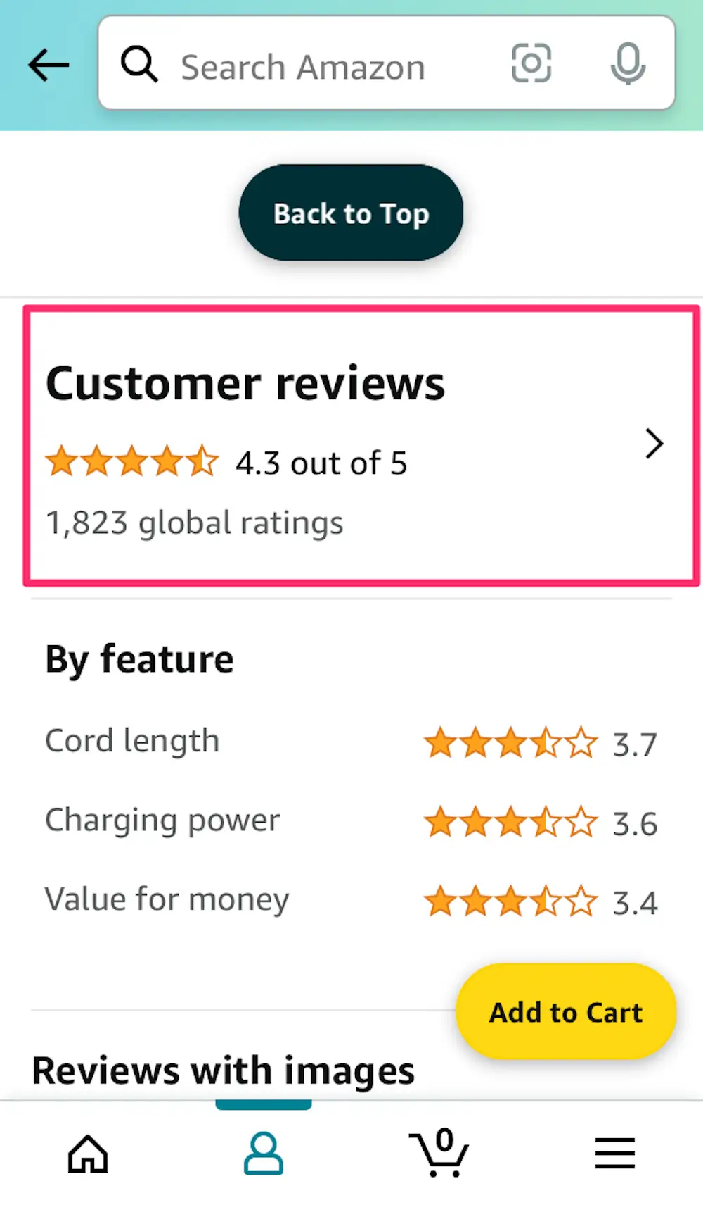

Slide 3
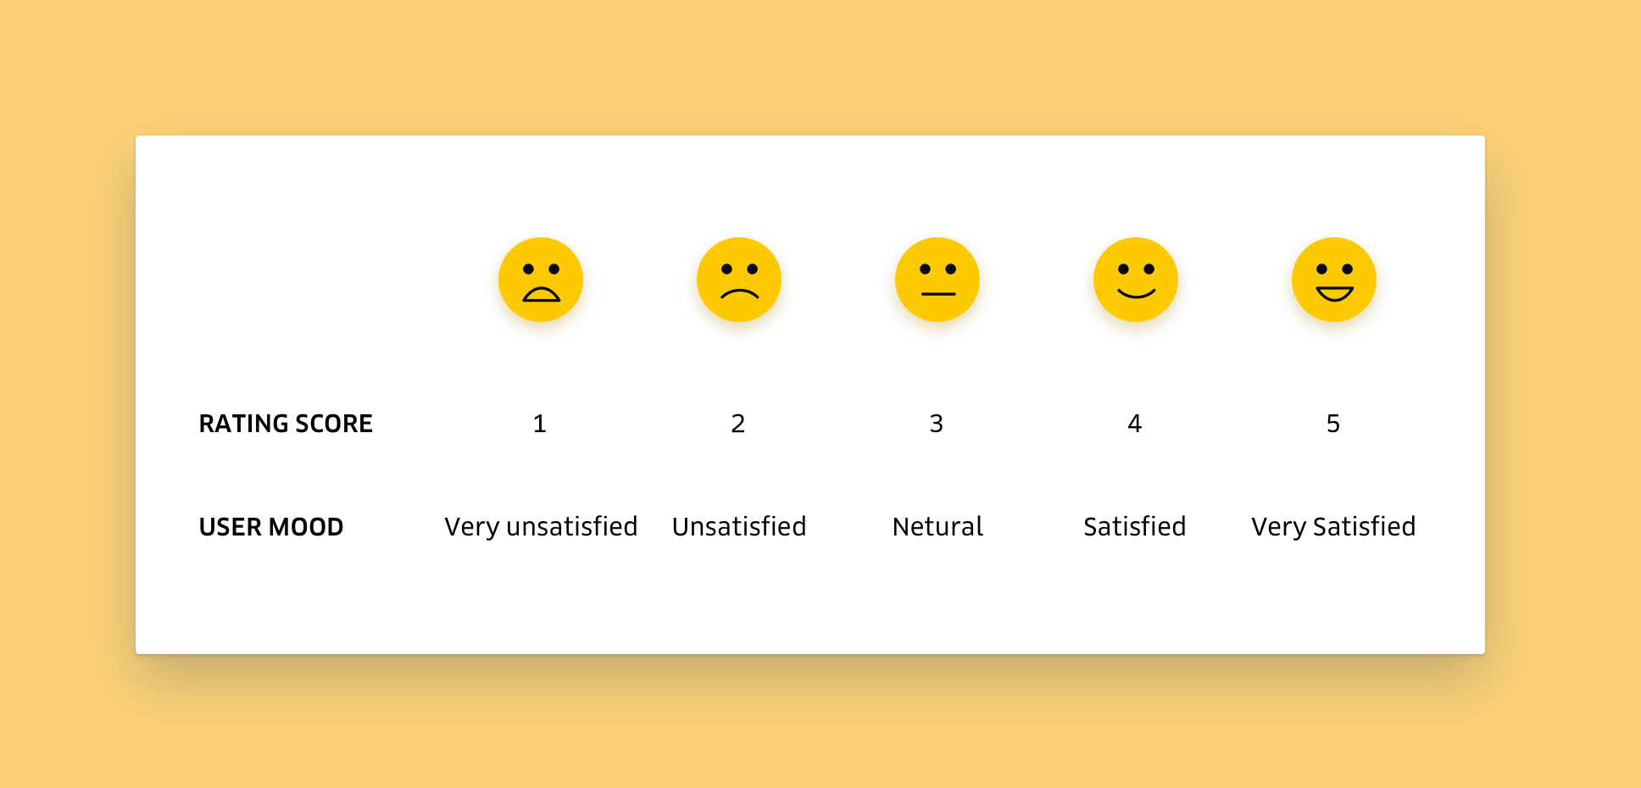
The review rating score on OLIST

Slide 4
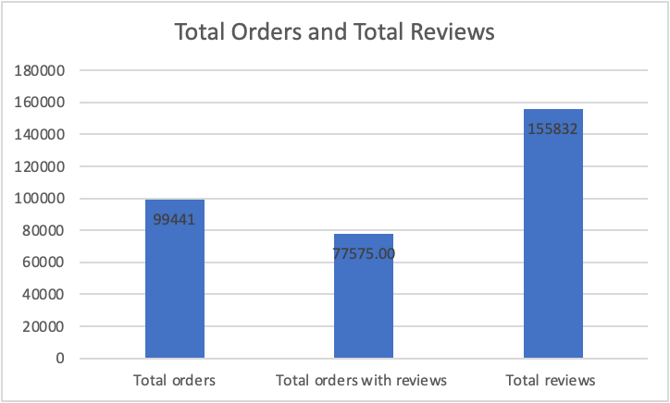
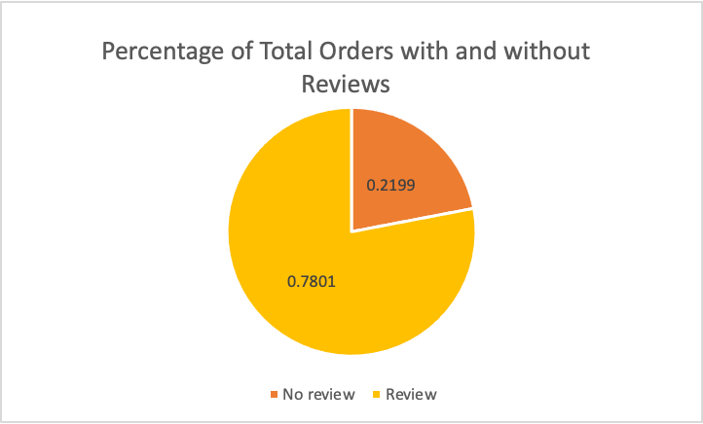
The big picture

Slide 5


ARE YOU MORE LIKELY
TO LEAVE A
GOOD OR BAD REVIEW?

Slide 6
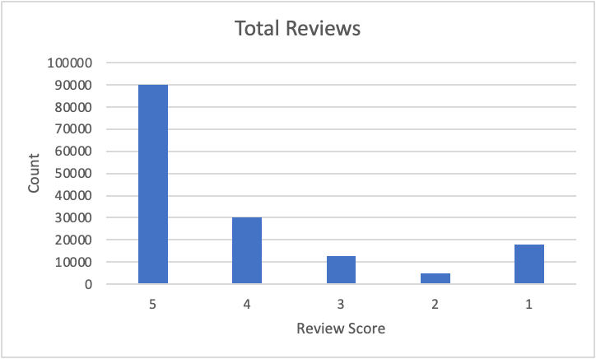
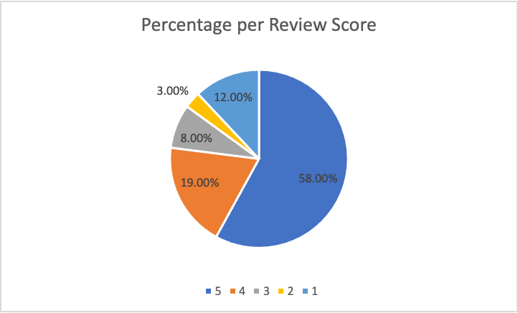
Are customers more likely to leave good or bad reviews?

Slide 7
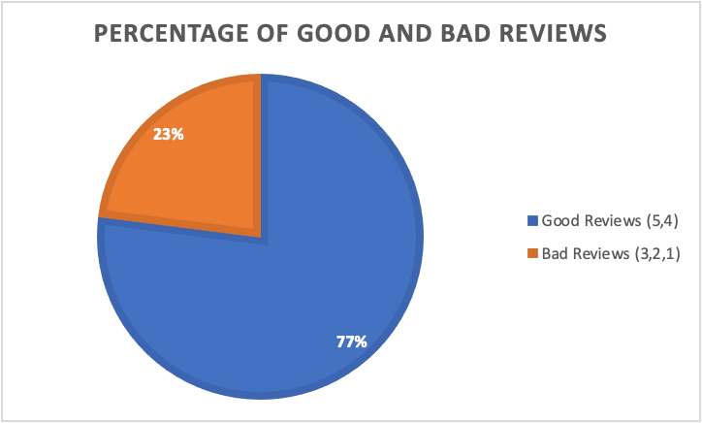

Slide 8
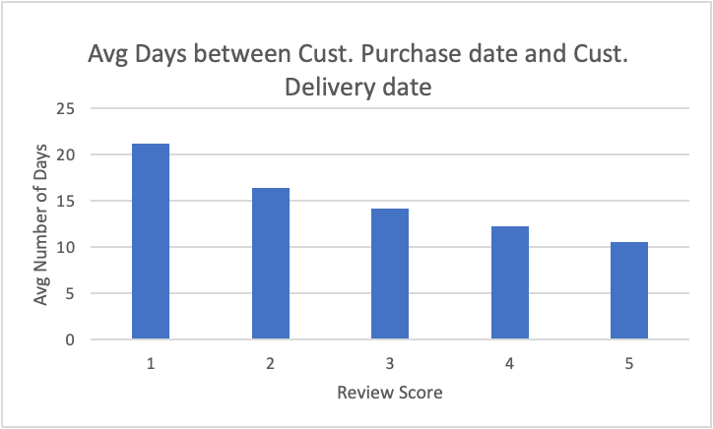
LET’S COMPARE AVG DELIVERY PERFORMANCE ACROSS RATING SCORES!

Slide 9

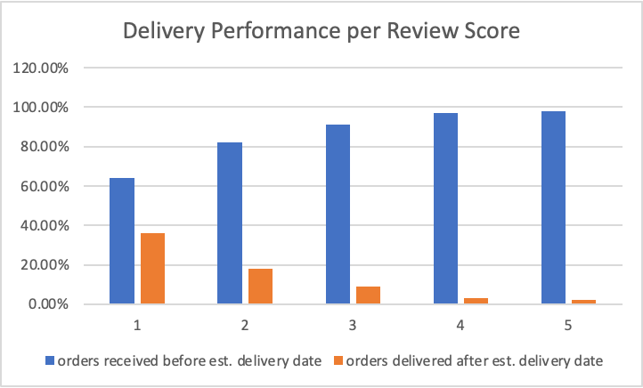
ARE CUSTOMERS HAPPIER WITH BETTER DELIVERY PERFORMANCE?

Slide 10
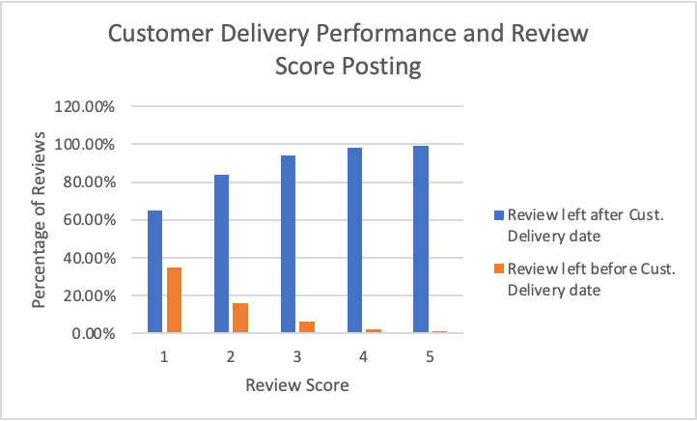
How soon after delivery do customers leave reviews?

Slide 11
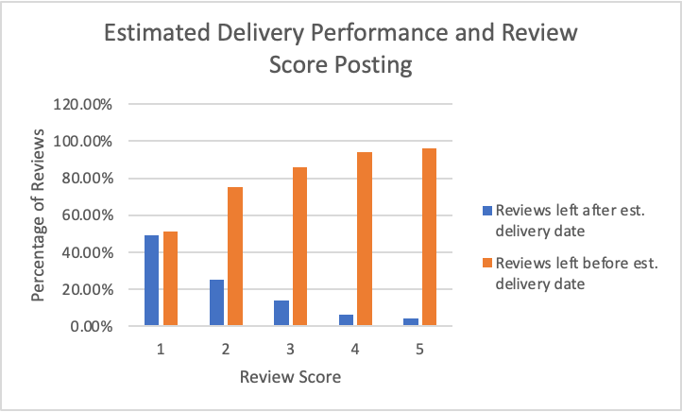
CUSTOMER REVIEWS BEFORE AND AFTER ESTIMATED DELIVERY DATE?

Slide 12

E-commerce will only continue to expand!
future
Factors impacting delivery performance
Demographics of those who leave reviews.
Translate review comments and categorize them by factors such as delivery performance, product quality, etc.
Analysis of reviews and comments: do people continue with their purchase after viewing good or bad reviews?
What kind of comments do people rely on? Those for good and bad reviews?
Compare ecommerce to in store sales: How do store managers receive feedback from customers?

